Slide 1

Web scraping to gain company insights
21/08/2024

Slide 2
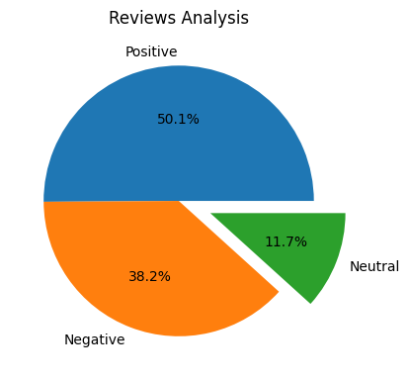
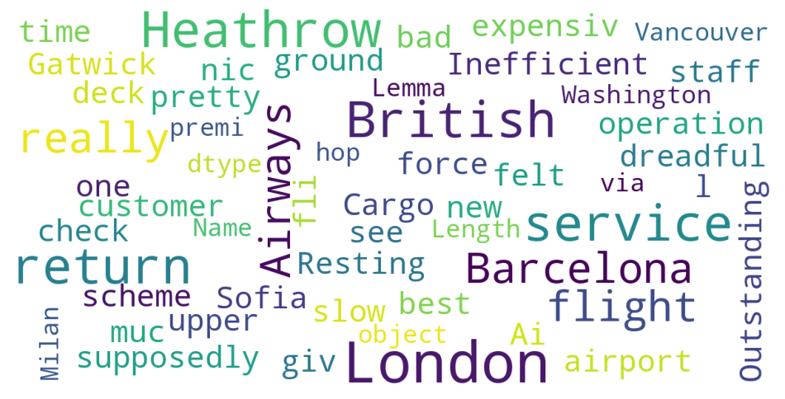
INSIGHTS FROM CUSTOMER REVIEWS
From cleaning 2000 reviews given by the customers, we obtained
Positive Reviews – 1002
Negative Reviews - 764
Neutral Reviews – 234
Word cloud of keywords used in reviews

